Slide 1
Chapter 3: Processes

Slide 2
Outline
Process Concept
Process Scheduling
Operations on Processes
Interprocess Communication
IPC in Shared-Memory Systems
IPC in Message-Passing Systems
Examples of IPC Systems
Communication in Client-Server Systems

Slide 3
Process Concept
An operating system executes a variety of programs that run as a process.
Process – a program in execution; process execution must progress in sequential fashion. No parallel execution of instructions of a single process
Multiple parts
The program code, also called text section
Current activity including program counter, processor registers
Stack containing temporary data
Function parameters, return addresses, local variables
Data section containing global variables
Heap containing memory dynamically allocated during run time

Slide 4
Process Concept (Cont.)
Program is passive entity stored on disk (executable file); process is active
Program becomes process when an executable file is loaded into memory
Execution of program started via GUI mouse clicks, command line entry of its name, etc.
One program can be several processes
Consider multiple users executing the same program

Slide 5
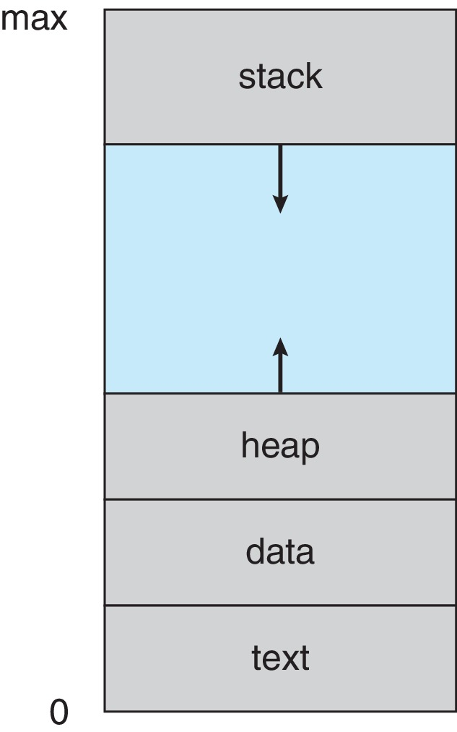
Process in Memory

Slide 6
Process State
As a process executes, it changes state
New: The process is being created
Running: Instructions are being executed
Waiting: The process is waiting for some event to occur
Ready: The process is waiting to be assigned to a processor
Terminated: The process has finished execution

Slide 7
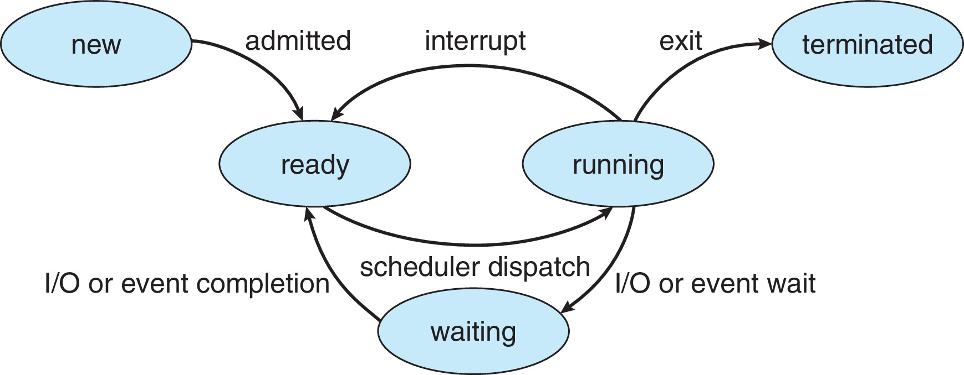
Diagram of Process State

Slide 8
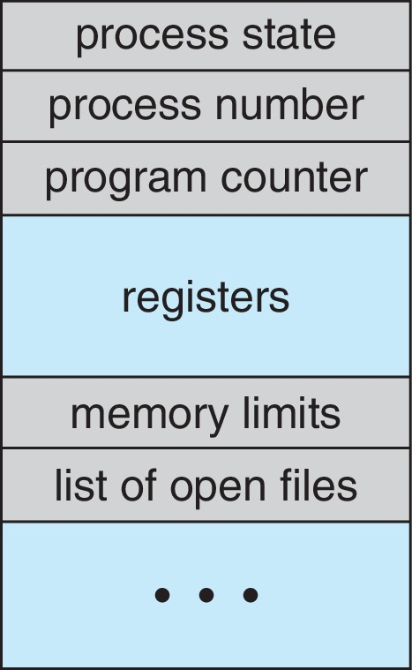
Process Control Block (PCB)
Information associated with each process(also called task control block)
Process state – running, waiting, etc.
Program counter – location of instruction to next execute
CPU registers – contents of all process-centric registers
CPU scheduling information- priorities, scheduling queue pointers
Memory-management information – memory allocated to the process
Accounting information – CPU used, clock time elapsed since start, time limits
I/O status information – I/O devices allocated to process, list of open files

Slide 9
Threads
So far, process has a single thread of execution
Consider having multiple program counters per process
Multiple locations can execute at once
Multiple threads of control -> threads
Must then have storage for thread details, multiple program counters in PCB
Explore in detail in Chapter 4

Slide 10
Process Scheduling
Process scheduler selects among available processes for next execution on CPU core
Goal -- Maximize CPU use, quickly switch processes onto CPU core
Maintains scheduling queues of processes
Ready queue – set of all processes residing in main memory, ready and waiting to execute
Wait queues – set of processes waiting for an event (i.e., I/O)
Processes migrate among the various queues

Slide 11
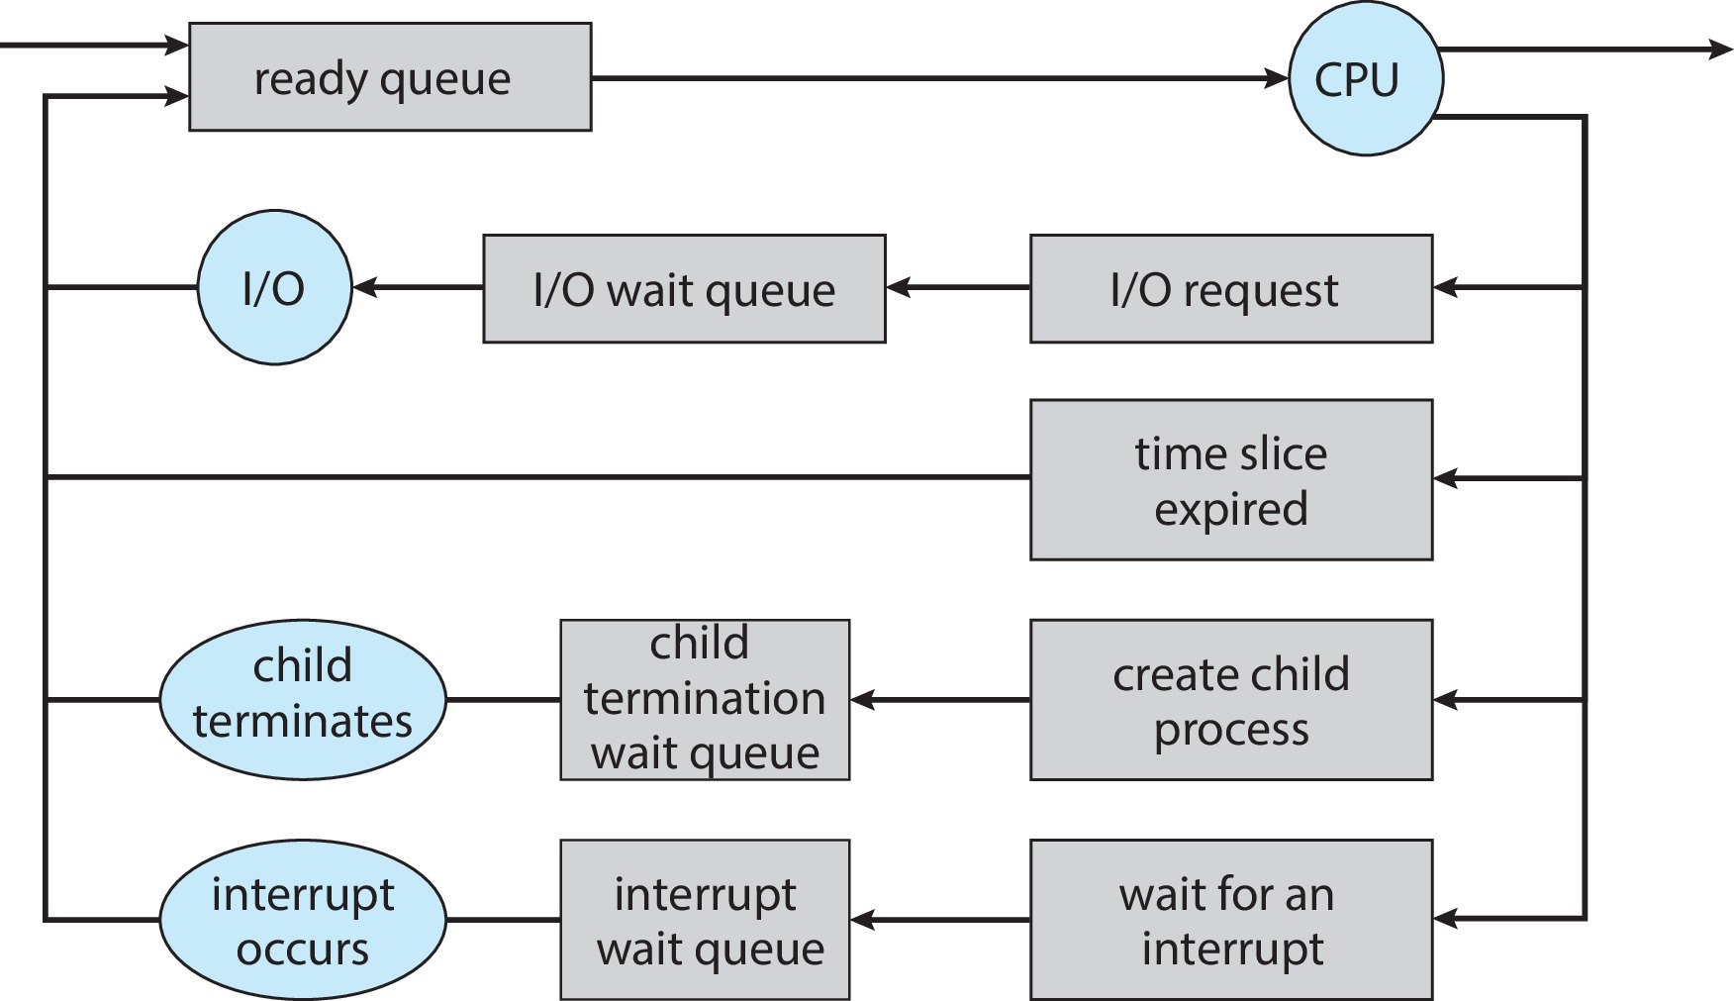
Representation of Process Scheduling

Slide 12
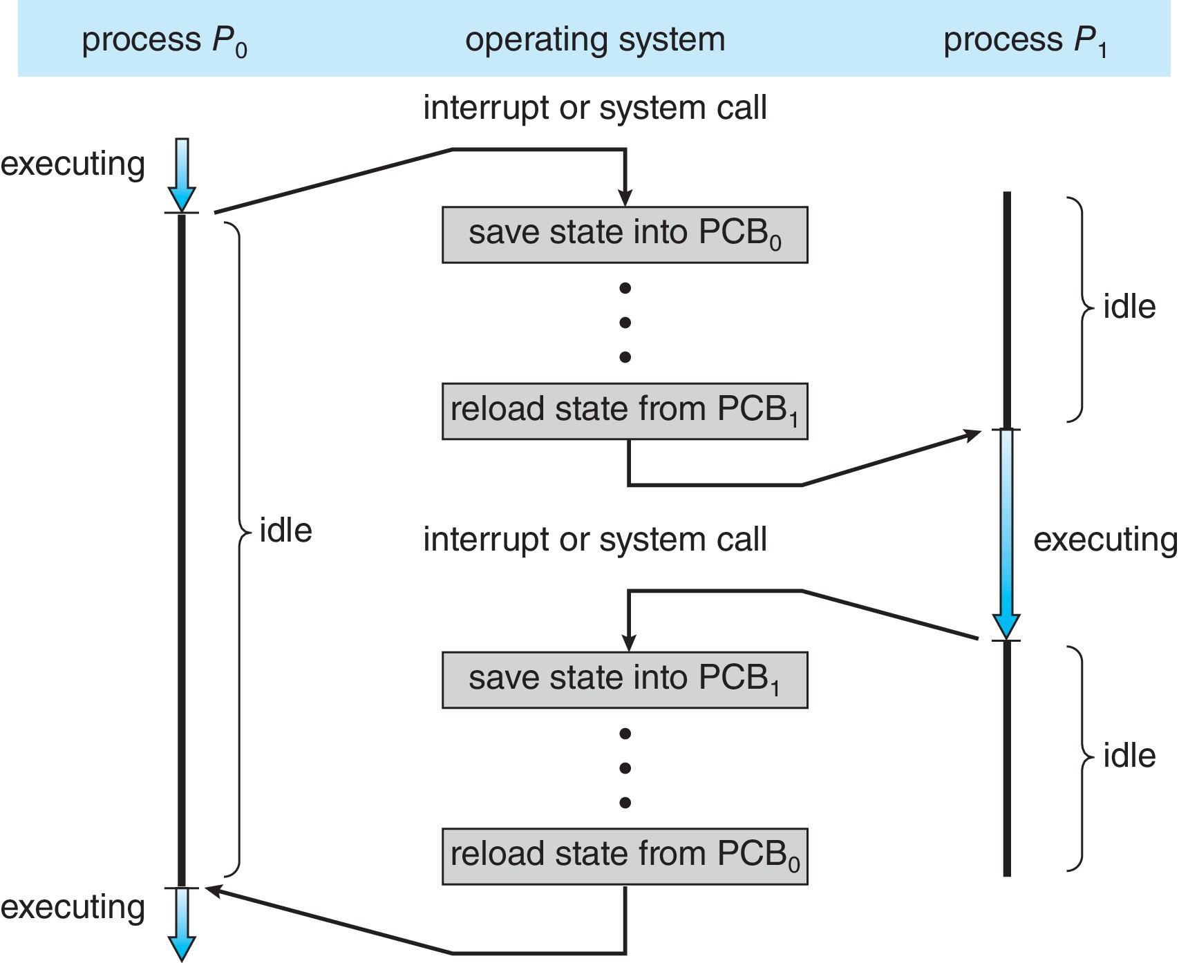
CPU Switch From Process to Process
A context switch occurs when the CPU switches from one process to another.

Slide 13
Context Switch
When CPU switches to another process, the system must save the state of the old process and load the saved state for the new process via a context switch
Context of a process represented in the PCB
Context-switch time is pure overhead; the system does no useful work while switching
The more complex the OS and the PCB ➔ the longer the context switch
Time dependent on hardware support
Some hardware provides multiple sets of registers per CPU ➔ multiple contexts loaded at once

Slide 14
Operations on Processes
System must provide mechanisms for:
Process creation
Process termination

Slide 15
Process Creation
Parent process create children processes, which, in turn create other processes, forming a tree of processes
Generally, process identified and managed via a process identifier (pid)
Resource sharing options
Parent and children share all resources
Children share subset of parent’s resources
Parent and child share no resources
Execution options
Parent and children execute concurrently
Parent waits until children terminate

Slide 16
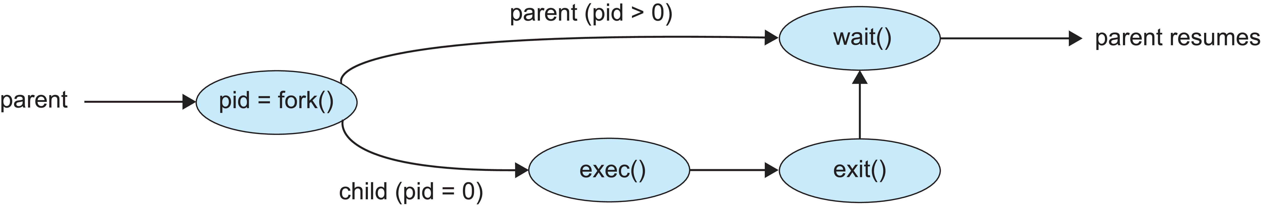
Process Creation (Cont.)
Address space
Child duplicate of parent
Child has a program loaded into it
UNIX examples
fork() system call creates new process
exec() system call used after a fork() to replace the process’ memory space with a new program
Parent process calls wait()waiting for the child to terminate

Slide 17
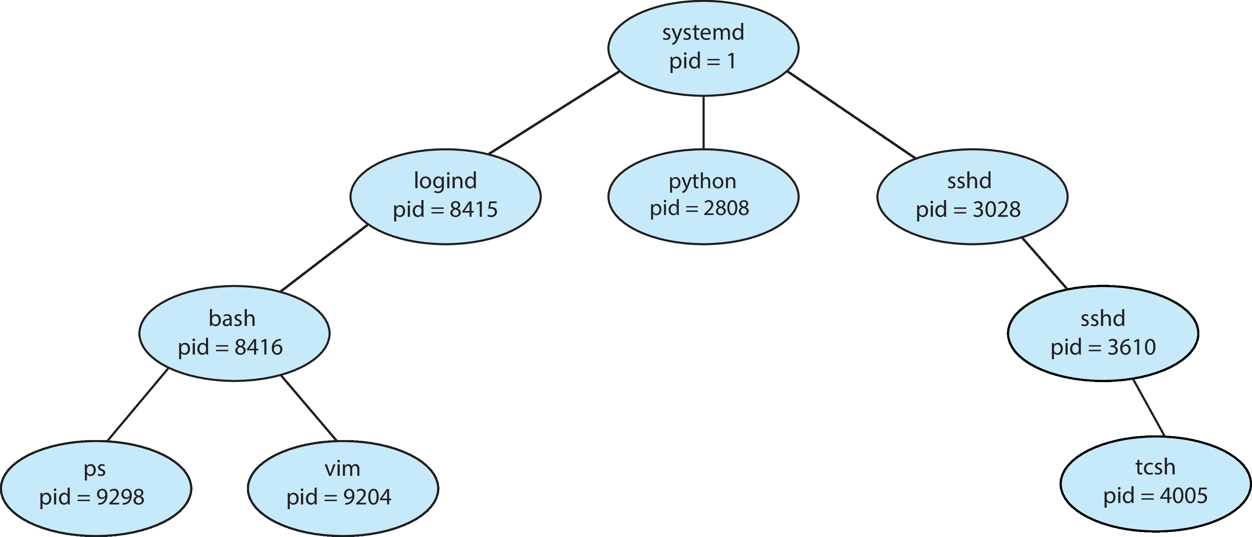
A Tree of Processes in Linux

Slide 18
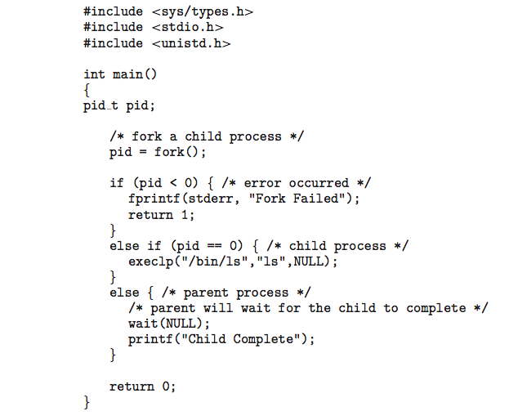
C Program Forking Separate Process

Slide 19
Process Termination
Process executes last statement and then asks the operating system to delete it using the exit() system call.
Returns status data from child to parent (via wait())
Process’ resources are deallocated by operating system
Parent may terminate the execution of children processes using the abort() system call. Some reasons for doing so:
Child has exceeded allocated resources
Task assigned to child is no longer required
The parent is exiting, and the operating systems does not allow a child to continue if its parent terminates

Slide 20
Process Termination
Some operating systems do not allow child to exists if its parent has terminated. If a process terminates, then all its children must also be terminated.
cascading termination. All children, grandchildren, etc., are terminated.
The termination is initiated by the operating system.
The parent process may wait for termination of a child process by using the wait()system call. The call returns status information and the pid of the terminated process
pid = wait(&status);
If no parent waiting (did not invoke wait()) process is a zombie
If parent terminated without invoking wait(), process is an orphan

Slide 21
Android Process Importance Hierarchy
Mobile operating systems often have to terminate processes to reclaim system resources such as memory. From most to least important:
Foreground process
Visible process
Service process
Background process
Empty process
Android will begin terminating processes that are least important.

Slide 22

Multiprocess Architecture – Chrome Browser
Many web browsers ran as single process (some still do)
If one web site causes trouble, entire browser can hang or crash
Google Chrome Browser is multiprocess with 3 different types of processes:
Browser process manages user interface, disk and network I/O
Renderer process renders web pages, deals with HTML, Javascript. A new renderer created for each website opened
Runs in sandbox restricting disk and network I/O, minimizing effect of security exploits
Plug-in process for each type of plug-in

Slide 23
Interprocess Communication
Processes within a system may be independent or cooperating
Cooperating process can affect or be affected by other processes, including sharing data
Reasons for cooperating processes:
Information sharing
Computation speedup
Modularity
Convenience
Cooperating processes need interprocess communication (IPC)
Two models of IPC
Shared memory
Message passing

Slide 24
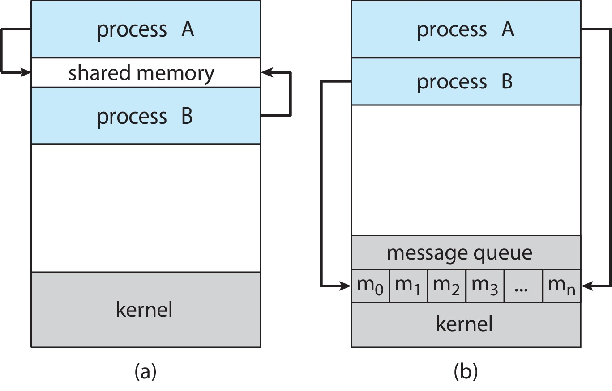
Communications Models
(a) Shared memory. (b) Message passing.

Slide 25
Producer-Consumer Problem
Paradigm for cooperating processes:
producer process produces information that is consumed by a consumer process
Two variations:
unbounded-buffer places no practical limit on the size of the buffer:
Producer never waits
Consumer waits if there is no buffer to consume
bounded-buffer assumes that there is a fixed buffer size
Producer must wait if all buffers are full
Consumer waits if there is no buffer to consume

Slide 26
IPC – Message Passing
Processes communicate with each other without resorting to shared variables
IPC facility provides two operations:
send(message)
receive(message)
The message size is either fixed or variable

Slide 27
Message Passing (Cont.)
If processes P and Q wish to communicate, they need to:
Establish a communication link between them
Exchange messages via send/receive
Implementation issues:
How are links established?
Can a link be associated with more than two processes?
How many links can there be between every pair of communicating processes?
What is the capacity of a link?
Is the size of a message that the link can accommodate fixed or variable?
Is a link unidirectional or bi-directional?

Slide 28
Implementation of Communication Link
Physical:
Shared memory
Hardware bus
Network
Logical:
Direct or indirect
Synchronous or asynchronous
Automatic or explicit buffering

Slide 29
Direct Communication
Processes must name each other explicitly:
send (P, message) – send a message to process P
receive(Q, message) – receive a message from process Q
Properties of communication link
Links are established automatically
A link is associated with exactly one pair of communicating processes
Between each pair there exists exactly one link
The link may be unidirectional, but is usually bi-directional

Slide 30
Indirect Communication
Messages are directed and received from mailboxes (also referred to as ports)
Each mailbox has a unique id
Processes can communicate only if they share a mailbox
Properties of communication link
Link established only if processes share a common mailbox
A link may be associated with many processes
Each pair of processes may share several communication links
Link may be unidirectional or bi-directional

Slide 31
Indirect Communication (Cont.)
Operations
Create a new mailbox (port)
Send and receive messages through mailbox
Delete a mailbox
Primitives are defined as:
send(A, message) – send a message to mailbox A
receive(A, message) – receive a message from mailbox A

Slide 32
Indirect Communication (Cont.)
Mailbox sharing
P₁, P₂, and P₃ share mailbox A
P₁, sends; P₂ and P₃ receive
Who gets the message?
Solutions
Allow a link to be associated with at most two processes
Allow only one process at a time to execute a receive operation
Allow the system to select arbitrarily the receiver. Sender is notified who the receiver was.

Slide 33
Synchronization
Message passing may be either blocking or non-blocking
Blocking is considered synchronous
Blocking send -- the sender is blocked until the message is received
Blocking receive -- the receiver is blocked until a message is available
Non-blocking is considered asynchronous
Non-blocking send -- the sender sends the message and continue
Non-blocking receive -- the receiver receives:
A valid message, or
Null message
Different combinations possible
If both send and receive are blocking, we have a rendezvous

Slide 34
Buffering
Queue of messages attached to the link.
Implemented in one of three ways
1. Zero capacity – no messages are queued on a link. Sender must wait for receiver (rendezvous)
2. Bounded capacity – finite length of n messages Sender must wait if link full
3. Unbounded capacity – infinite length Sender never waits

Slide 35
Examples of IPC Systems - POSIX
POSIX Shared Memory
Process first creates shared memory segment shm_fd = shm_open(name, O CREAT | O RDWR, 0666);
Also used to open an existing segment
Set the size of the object
ftruncate(shm_fd, 4096);
Use mmap() to memory-map a file pointer to the shared memory object
Reading and writing to shared memory is done by using the pointer returned by mmap().

Slide 36
Examples of IPC Systems - Mach
Mach communication is message based
Even system calls are messages
Each task gets two ports at creation - Kernel and Notify
Messages are sent and received using the mach_msg() function
Ports needed for communication, created via
mach_port_allocate()
Send and receive are flexible; for example four options if mailbox full:
Wait indefinitely
Wait at most n milliseconds
Return immediately
Temporarily cache a message

Slide 37
Examples of IPC Systems – Windows
Message-passing centric via advanced local procedure call (LPC) facility
Only works between processes on the same system
Uses ports (like mailboxes) to establish and maintain communication channels
Communication works as follows:
The client opens a handle to the subsystem’s connection port object.
The client sends a connection request.
The server creates two private communication ports and returns the handle to one of them to the client.
The client and server use the corresponding port handle to send messages or callbacks and to listen for replies.

Slide 38
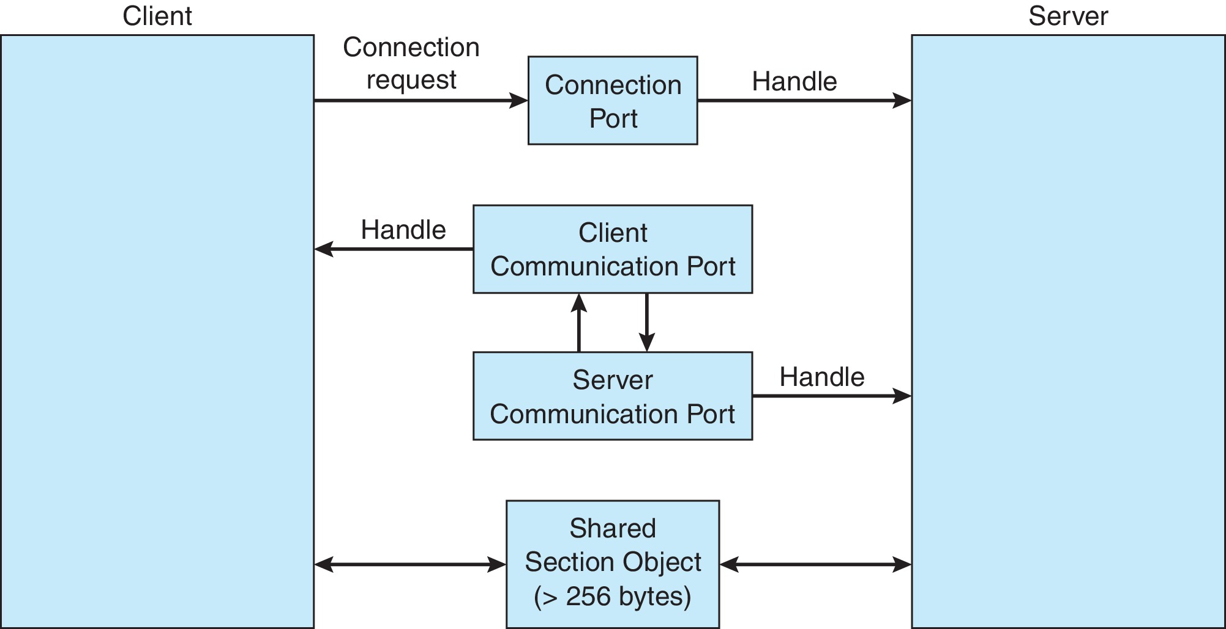
Local Procedure Calls in Windows

Slide 39
Pipes
Acts as a conduit allowing two processes to communicate
Issues:
Is communication unidirectional or bidirectional?
In the case of two-way communication, is it half or full-duplex?
Must there exist a relationship (i.e., parent-child) between the communicating processes?
Can the pipes be used over a network?
Ordinary pipes – cannot be accessed from outside the process that created it. Typically, a parent process creates a pipe and uses it to communicate with a child process that it created.
Named pipes – can be accessed without a parent-child relationship.

Slide 40
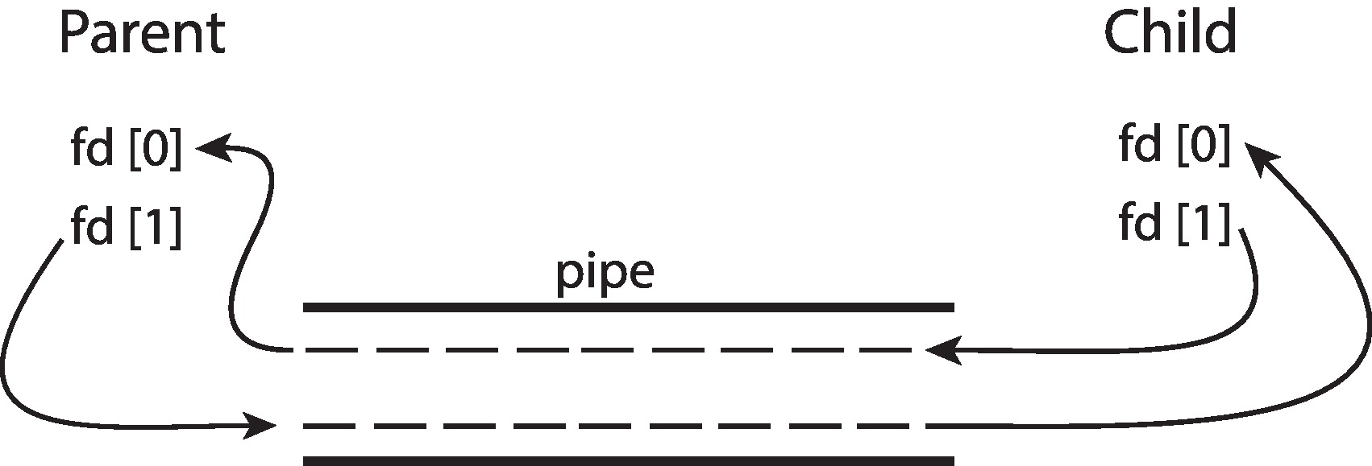
Ordinary Pipes
Ordinary Pipes allow communication in standard producer-consumer style
Producer writes to one end (the write-end of the pipe)
Consumer reads from the other end (the read-end of the pipe)
Ordinary pipes are therefore unidirectional
Require parent-child relationship between communicating processes
Windows calls these anonymous pipes

Slide 41
Named Pipes
Named Pipes are more powerful than ordinary pipes
Communication is bidirectional
No parent-child relationship is necessary between the communicating processes
Several processes can use the named pipe for communication
Provided on both UNIX and Windows systems

Slide 42
Communications in Client-Server Systems
Sockets
Remote Procedure Calls

Slide 43
Sockets
A socket is defined as an endpoint for communication
Concatenation of IP address and port – a number included at start of message packet to differentiate network services on a host
The socket 161.25.19.8:1625 refers to port 1625 on host 161.25.19.8
Communication consists between a pair of sockets
All ports below 1024 are well known, used for standard services
Special IP address 127.0.0.1 (loopback) to refer to system on which process is running

Slide 44
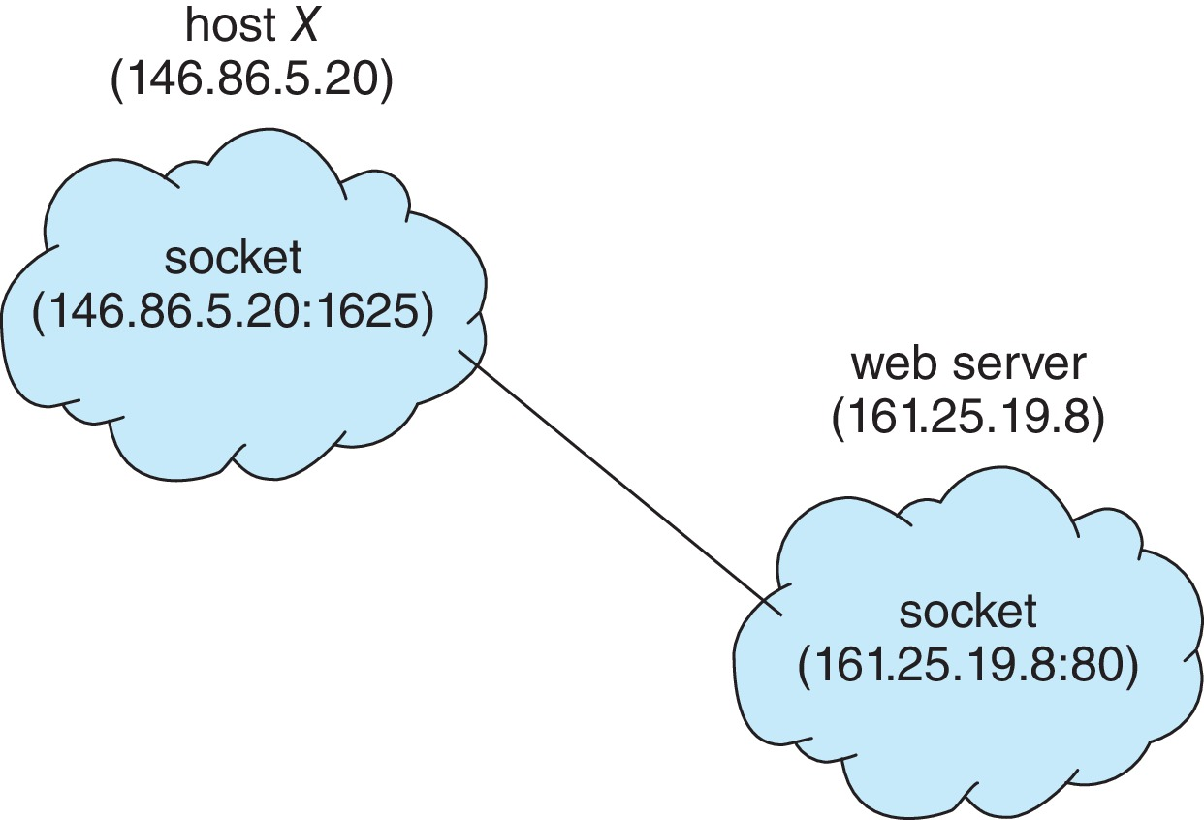
Socket Communication

Slide 45
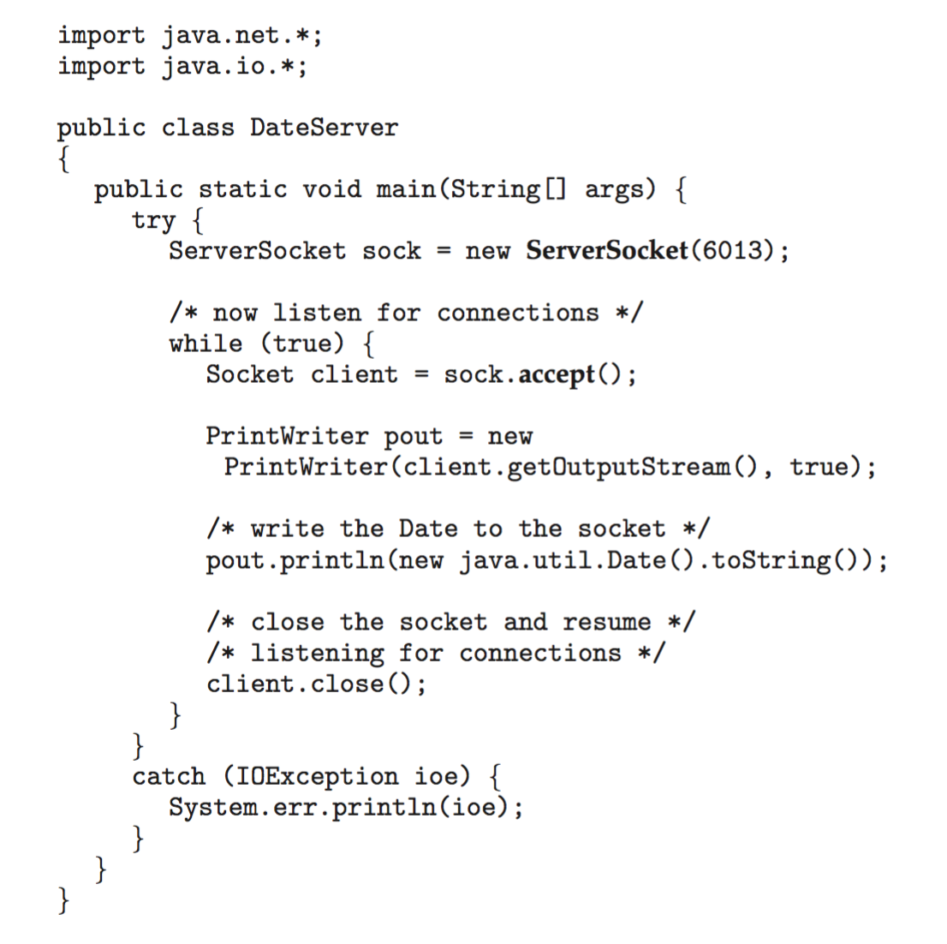
Sockets in Java
Three types of sockets
Connection-oriented (TCP)
Connectionless (UDP)
MulticastSocket class– data can be sent to multiple recipients
Consider this “Date” server in Java:

Slide 46
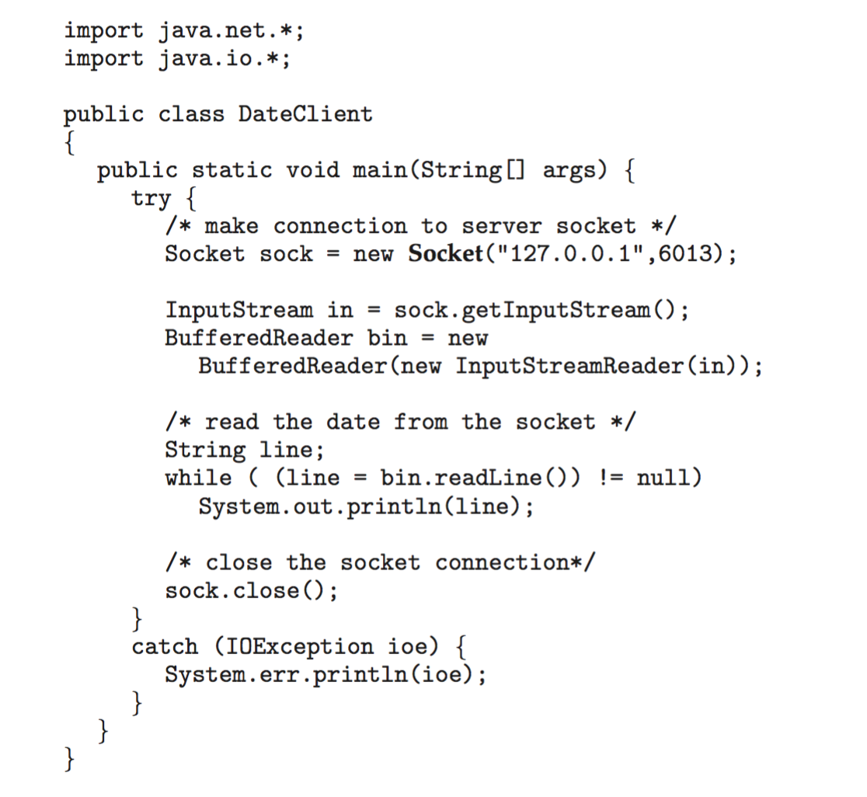
Sockets in Java
The equivalent Date client

Slide 47
End of Chapter 3

